Slide 1

Three-Phase Imaging Using Electrical Capacitance Volume Tomography and Multiphase Flow Decomposition
Qussai Marashdeh,
Tech4Imaging LLC

Slide 2
Introduction
Gas-liquid-solid reactor systems have been applied extensively to commercial operations for physical, chemical, petrochemical, electrochemical, and biochemical processing ….
Gas-liquid-solid flows are complex! To understand the three-phase flows thereby quantifying the phase hold-up distributions and their dynamic characteristics, advanced measuring techniques are required.
Available imaging technologies that can visualize three phase flows are very limited.
Multi-Phase Flow Decomposition using ECVT is a new innovative advancement that responds to the instrumentation need of three-phase applications.

Slide 3
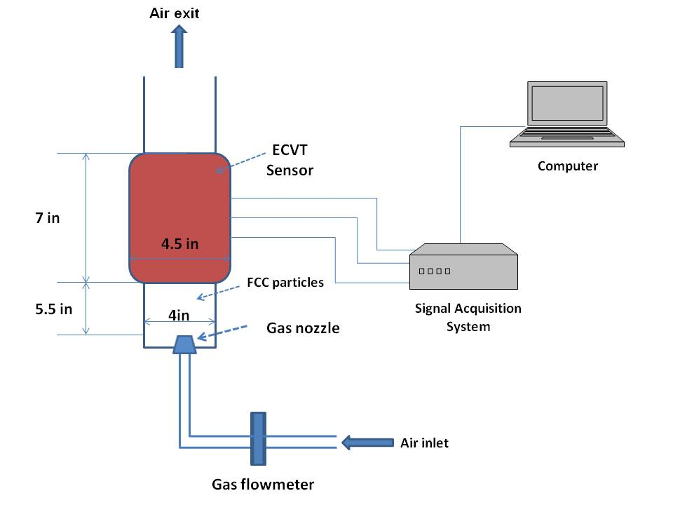
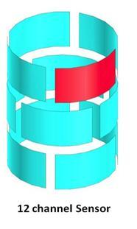
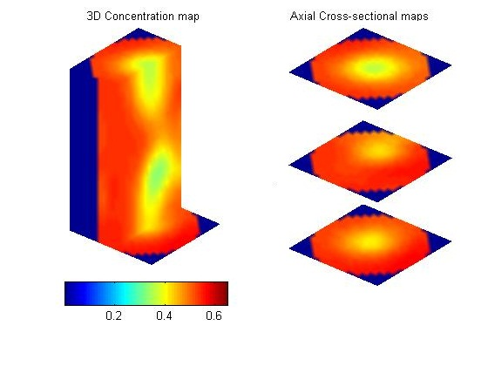
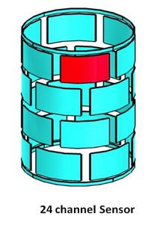
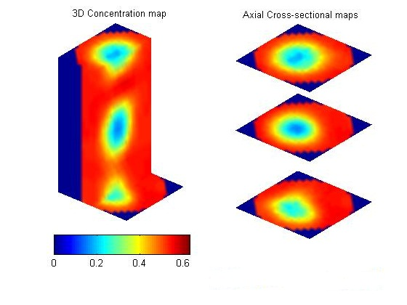
Current ECVT: Two phase only Example: Gas-Solid Experiment- Clod Flow

Slide 4
Three Phase Instrumentation Needs: The Need
Velocities of each phase in a three phase system
Volume fractions and distribution of each phase
Mass flow rate of each phase
Catalyst volume estimation
Reaction rate
Solving the problem of more than three phases

Slide 5
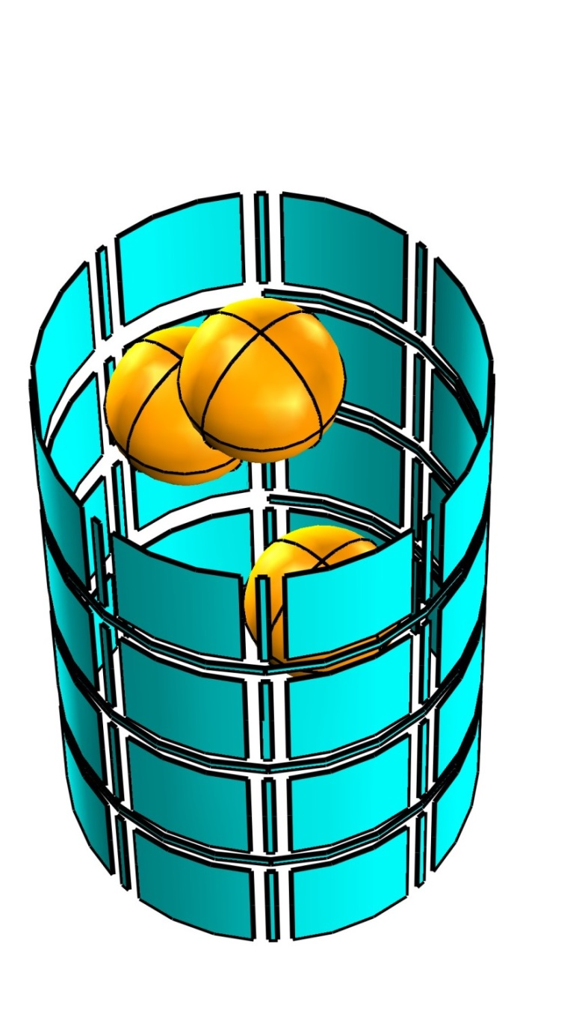
Three Phase Imaging: Multiphase Flow Decomposition
3-Phase Flows
Discrete
Well mixed

Slide 6
Multi-Phase Flow Decomposition
Phase A
Phase C
ECVT Imaging
ECVT Phase
Decomposition
Phase B

Slide 7
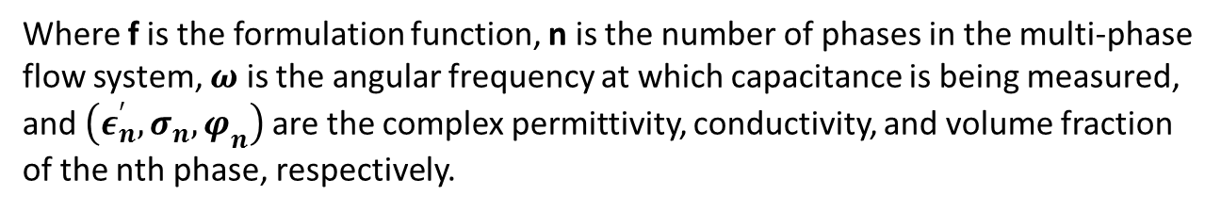
Maxwell–Wagner–Sillars (MWS) polarization
MWS effect: mixture with one component having conductivity has different effective dielectric constant as function of frequency
This phenomena happens only to mixtures, not single phases
Effective dielectric constant is function of each phase electrical properties, volume fraction, and frequency.
In ECVT, we can choose frequency, electrical properties of each phase are known, we can then solve for volume fraction distribution of each phase
$$ε_{effective}=f\left(\left(ε_{1}^{′},σ_{1},φ_{1}\right),\left(ε_{2}^{′},σ_{2},φ_{2}\right)⋯\left(ε_{n}^{′},σ_{n},φ_{n}\right),ω\right)$$
Where f is the formulation function, n is the number of phases in the multi-phase flow system, $ω$ is the angular frequency at which capacitance is being measured, and $\left(ε_{n}^{′},σ_{n},φ_{n}\right)$ are the complex permittivity, conductivity, and volume fraction of the nth phase, respectively.

Slide 8




Maxwell–Wagner–Sillars (MWS) polarization
MWS effect: mixture with one component having conductivity has different effective dielectric constant as function of frequency
This phenomena happens only to mixtures, not single phases
Effective dielectric constant is function of each phase electrical properties, volume fraction, and frequency.
In ECVT, we can choose frequency, electrical properties of each phase are know, we can then solve for volume fraction distribution of each phase
$ε_{1}^{∗}=ε_{1s}+\frac{σ_{1}}{jωε_{0}}$
$ε_{2}^{∗}=ε_{2s}+\frac{σ_{2}}{jωε_{0}}$
$ε_{3}^{∗}=ε_{3s}+\frac{σ_{3}}{jωε_{0}}$
$ε^{∗}=H(ε_{3}^{∗},H\left(ε_{1}^{∗},ε_{2}^{∗},φ_{1}\right),φ_{2},w)$
Changing f will introduce new equations for solving higher order of phases

Slide 9

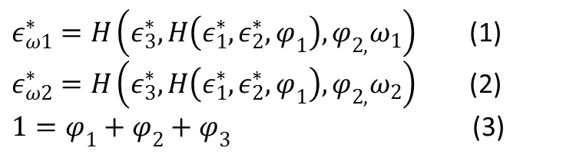



Problem Formulation
Properties of individual phases:
$ε_{1}^{∗}=ε_{1s}+\frac{σ_{1}}{jωε_{0}}$
$ε_{2}^{∗}=ε_{2s}+\frac{σ_{2}}{jωε_{0}}$
$ε_{3}^{∗}=ε_{3s}+\frac{σ_{3}}{jωε_{0}}$
Effective Dielectric Constant of Mixture:
$ε^{∗}=H(ε_{3}^{∗},H\left(ε_{1}^{∗},ε_{2}^{∗},φ_{1}\right),φ_{2},w)$
System of Equation for Three Phase Problem:
$ε_{ω1}^{∗}=H\left(ε_{3}^{∗},H\left(ε_{1}^{∗},ε_{2}^{∗},φ_{1}\right),φ_{2,}ω_{1}\right)$ (1)
$ε_{ω2}^{∗}=H\left(ε_{3}^{∗},H\left(ε_{1}^{∗},ε_{2}^{∗},φ_{1}\right),φ_{2,}ω_{2}\right)$ (2)
$1=φ_{1}+φ_{2}+φ_{3}$ (3)

Slide 10
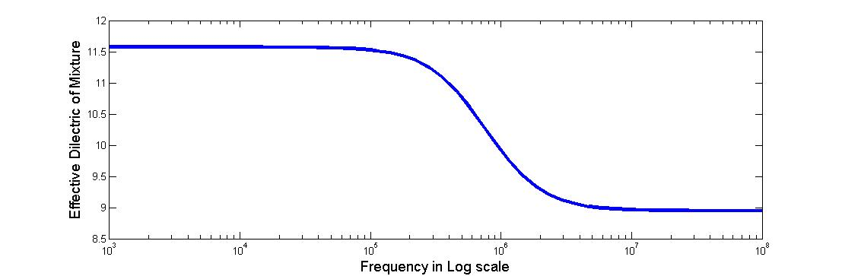



Oil Water system: Oil continuous phase
Oil:
$ε_{1}^{∗}=2.5+\frac{0}{jωε_{0}}$
Water:
$ε_{2}^{∗}=81+\frac{0.005}{jωε_{0}}$
Volume fraction of water 40%
Properties
Volume fraction
=> Frequency
Change in $ε_{}^{∗}$ ~ 22%

Slide 11
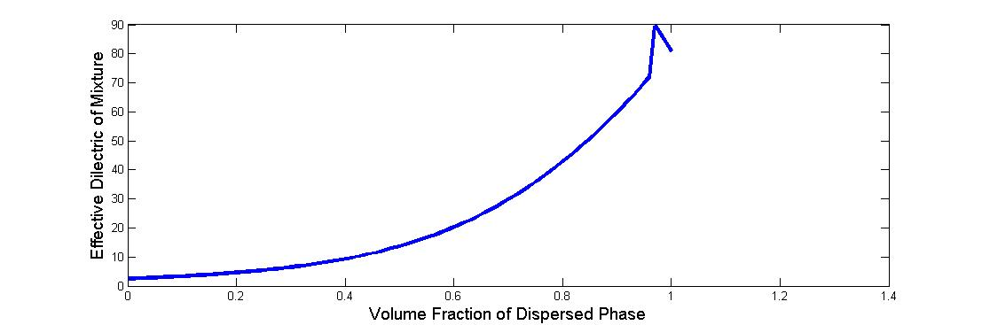
Oil Water system: Oil continuous phase
Oil:
$ε_{1}^{∗}=2.5+\frac{0}{jωε_{0}}$
Water:
$ε_{2}^{∗}=81+\frac{0.005}{jωε_{0}}$
f=2MHz
Properties
Volume fraction
=> Frequency

Slide 12
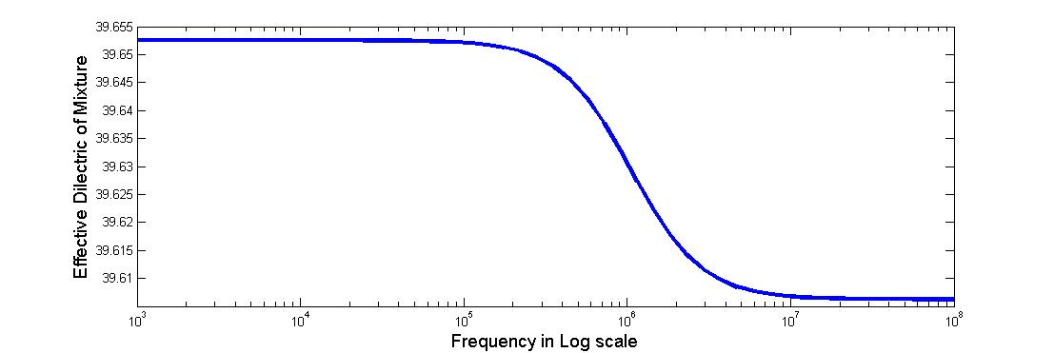

Water Oil system: Water continuous phase
Oil:
$ε_{1}^{∗}=2.5+\frac{0}{jωε_{0}}$
Water:
$ε_{2}^{∗}=81+\frac{0.005}{jωε_{0}}$
Volume fraction of Oil 40%
Properties
Volume fraction
=> Frequency
Change in $ε_{}^{∗}$ ~ 0.1%

Slide 13
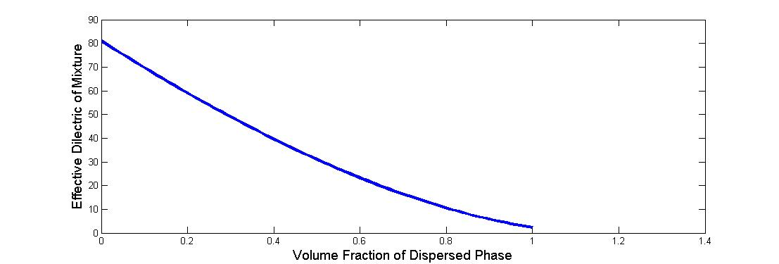
Water Oil system: Water continuous phase
Oil:
$ε_{1}^{∗}=2.5+\frac{0}{jωε_{0}}$
Water:
$ε_{2}^{∗}=81+\frac{0.005}{jωε_{0}}$
f=2MHz
Properties
Volume fraction
=> Frequency

Slide 14
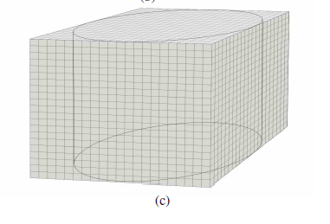
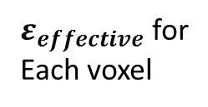
Solving image for each Voxel
$ε_{effective}$ for
Each voxel
2D
3D
Three Capacitance Measurements with Three reconstructed maps
Each voxel will have three equations with Volume fraction of each phase as the variable

Slide 15
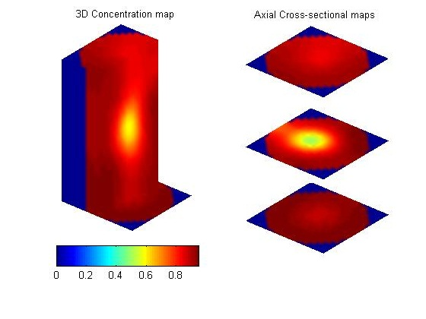
Solving Images to Phases
Image 1 at f1
Image 2 at f2
Image 3 at f3
Solve Three equations for each Voxel
Phase A
Phase B
Phase C

Slide 16
Phase decomposition process
1 Calibration
Determine frequency markers of mixture by sweep frequency calibration or by calculation from electrical properties of each phase in mixture
2 Measurement
Measure capacitance from ECT, ECVT, or AECVT sensors at all frequency markers determined in step 1
3 Reconstruction
Perform an image reconstruction of capacitance measurements at each frequency
A number of images equal to the number of frequency markers will be available in this step
4 Phase decomposition
For each Voxel in each image at a specific frequency, the effective dielectric constant is a function of electric properties of all phases and their volume fraction, assuming a well mixed cell
Each Voxel will a number of equations equal to the number of frequency markers. The only unknowns in those equations are the volume fraction of each phase.
The equations for each voxel are solved to determine the volume fraction of each phase in that voxel
5 phase viewing
From step 4, each voxel will have the volume fractions of each phase.
For each phase, the volume fractions of all voxels are gathered to formulate an image of that phase alone
Multiple images will be generated, each showing only one phase

Slide 17
Conclusion
Three Phase flows are complex and are being applied extensively in commercial applications.
Multi-Phase Flow Decomposition is a new technology for imaging and decomposing three-phase systems:
Mixtures have different effective dielectric constants at different frequencies.
This phenomena, known as MWS effect, can be exploited to decompose a three-phase system into individual phases for imaging.
Capacitance is captured at different frequencies and images are reconstructed at each frequency.
The three images are then solved together for phase decomposition.

